Slide 1
Human-computer Interaction Project 1 – caixa econômica federal p3 – 14/03/2023
Bruno Acioli – 101077
Marco Magalhães – 101061
Patrícia Cardoso - 103243

Slide 2
cONTEXT
Caixa Econômica Federal is a brazilian public bank and its website allow users to do their daily financial operations
We chose this website because our families have to use this website and they constantly have problems.

Slide 3
Goal
Evaluate the system usability using Heuristic Evaluation and Cognitive Walkthrough
Heuristic evaluation and Cognitive Walkthrough are an usability inspection methods used to evaluate the user interface (UI) design of a digital product or system, such as a website, mobile app, or software application.

Slide 4
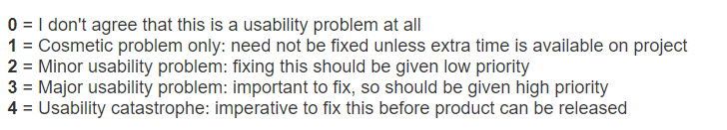
Heuristics AND rating scale
Visibility of system status
Match between system and the real world
User control and freedom
Consistency and standards
Error prevention
Recognition rather than recall
Flexibility and efficiency of use
Aesthetic and minimalist design
Help users recognize, diagnose, and recover from errors
Help and documentation

Slide 5
Problems found
Name | Usability Principle | Marco’s grade | Patrícia’s grade | Bruno’s grade | Median
English Translation | Consistency and standards | 4 | 4 | 3 | 4
Sign Language Translator | Match between system and the real world | 3 | 3 | 3 | 3
Menu’s Tile | Visibility of System Status | 1 | 2 | 1 | 1
Tools Icon | Visibility of System Status | 2 | 2 | 2 | 2
Computer Registration | Visibility of System Status | 1 | 2 | 2 | 2

Slide 6
Problems found
Name | Usability Principle | Marco’s grade | Patrícia’s grade | Bruno’s grade | Median
Search on Download Page | Consistency and standards | 3 | 3 | 3 | 3
QR Code | Help users recognize, diagnose, and recover from errors | 3 | 4 | 4 | 4
Access Internet Banking | Help users recognize, diagnose, and recover from errors | 4 | 3 | 4 | 4

Slide 7
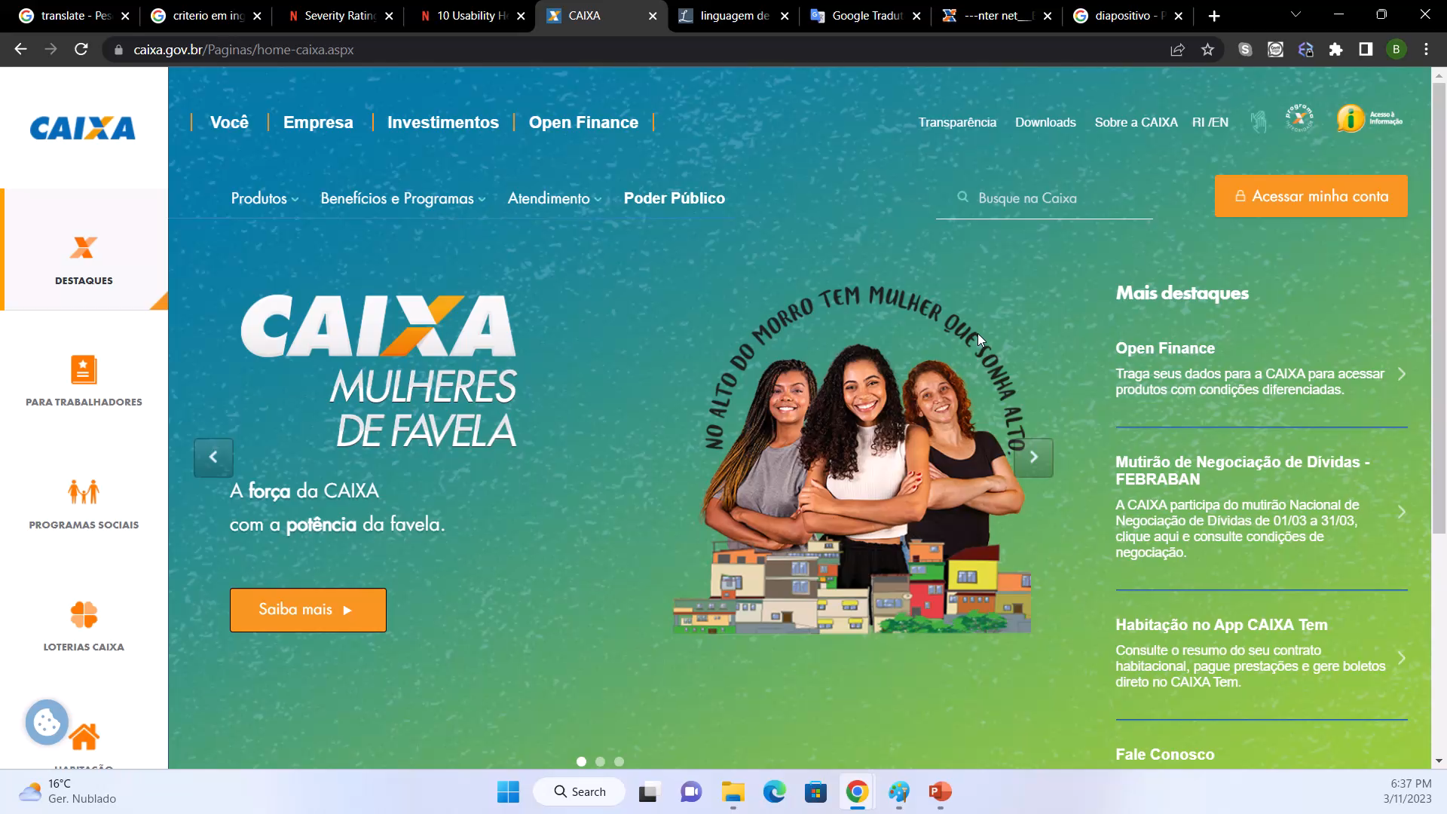
EnGLish Translation PRINCIPLE: Consistency and standards Median: 4

Slide 8
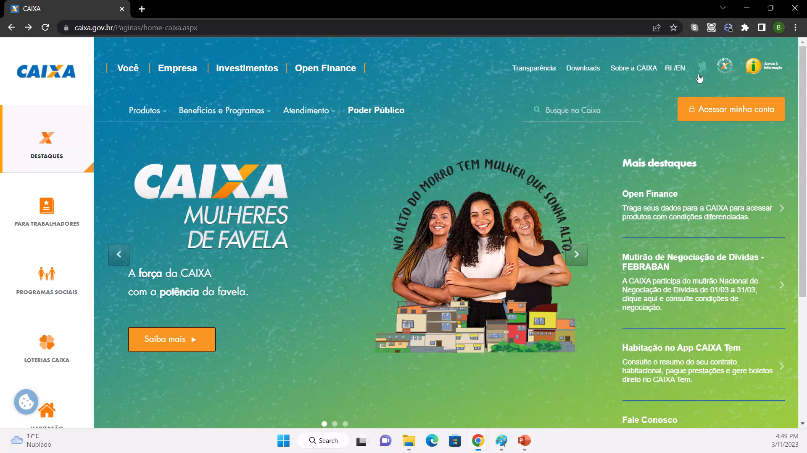
Sign Language Translator Principle: Match between system and the real world median: 3

Slide 9

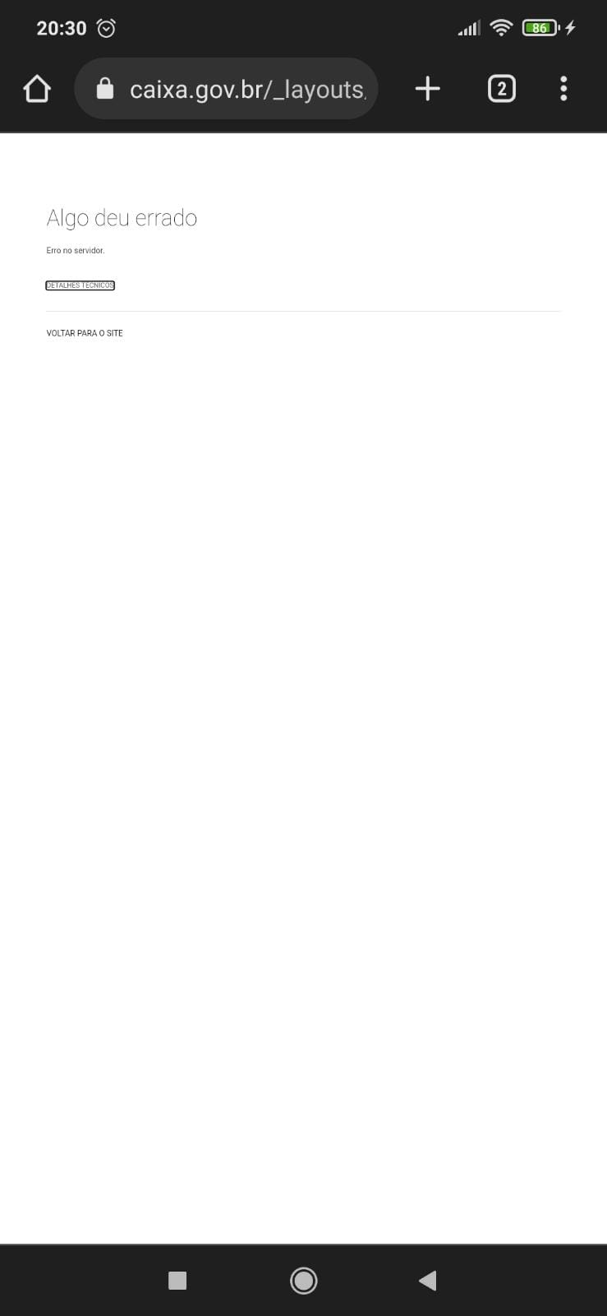
QR Code PRINCIPLE: Help users recognize, diagnose, and recover from errors MEDIAN: 4

Slide 10

Access Internet Banking Principle: Help users recognize, diagnose, and recover from errors Median: 4

Slide 11
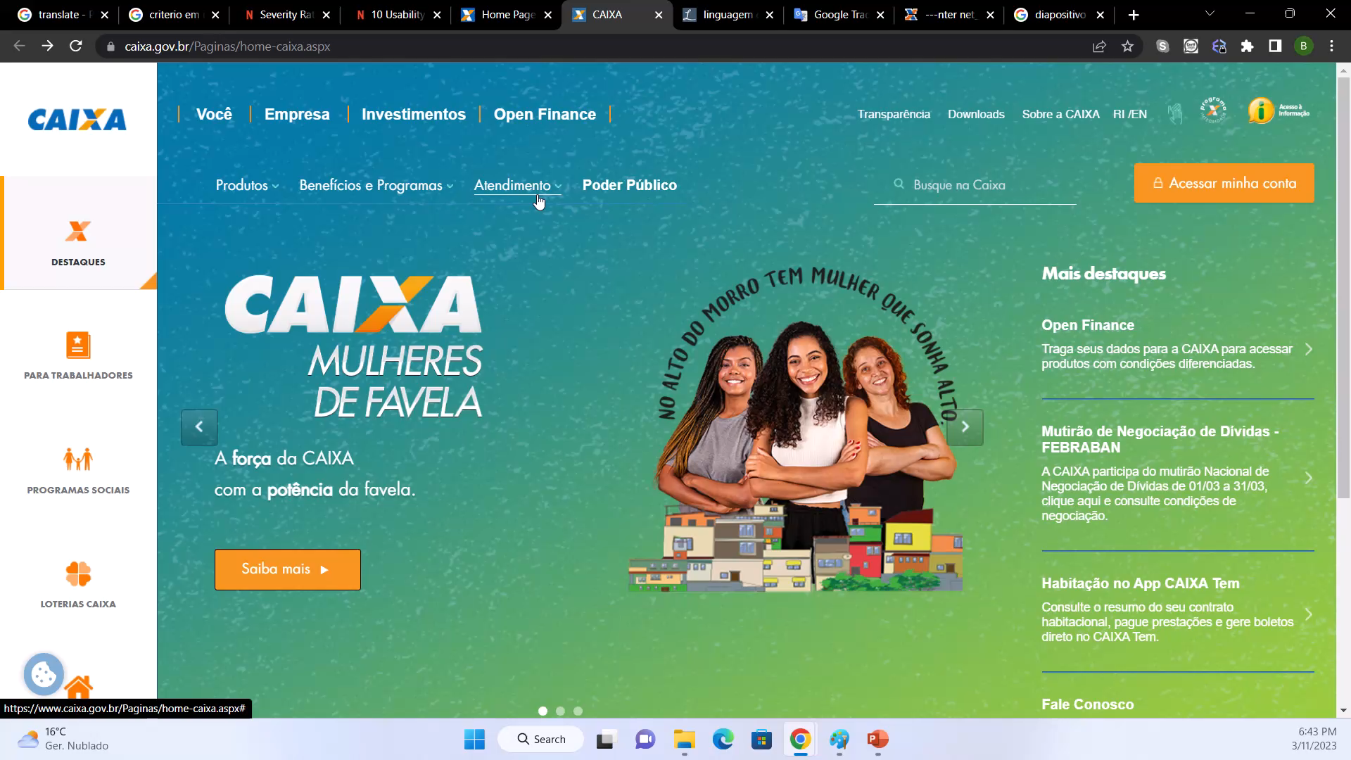
SEARCH ON DOWNLOAD PAGE principle: Consistency and standards median: 3

Slide 12
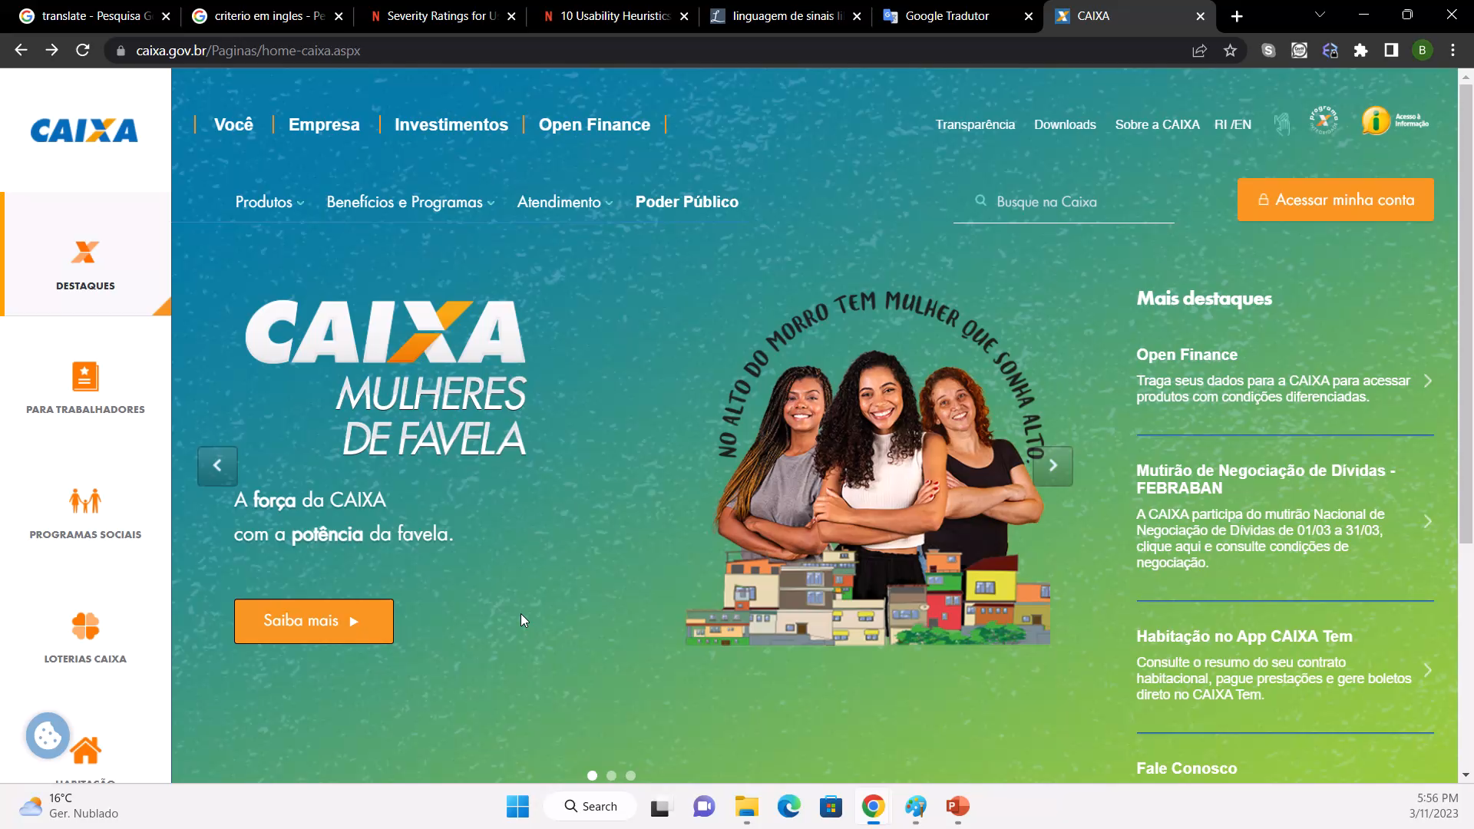
Computer registration PRINCIPLE: Visibility of System Status MEDIAN : 2

Slide 13
Streamlined Cognitive walkthrough
Task: See more information about registering
User: Any person with a Caixa account that wants to use the Internet Banking

Slide 14
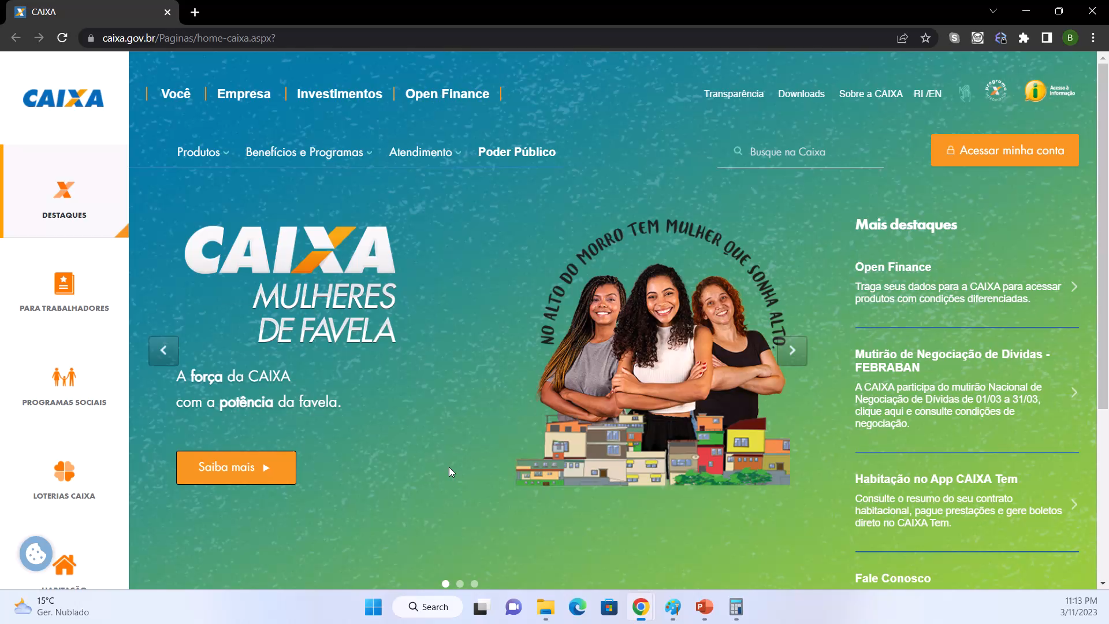

Slide 15
Task analysis
Look for the “Acessar minha conta” button
Scroll down the page and look for the “Senha e usuário” section
Click on the “clique aqui” link to know more information
Check the pop-up and click on the “clique aqui” link again
Check the information

Slide 16
sTEP 1 - Look for the “Acessar minha conta” button
Q1 - Will the user know what to do at this step?
Probably yes, the button is pretty visible
Q2 - If the user does the right thing (selects the icon), will they know that they did the right thing, and are making progress towards their goal?
Yes, the new page will have information about logging in and registering

Slide 17
STEP 2 - Scroll down the page and look for the “Senha e usuário” section
Q1 - Will the user know what to do at this step?
Probably yes, the user just has to scroll down the page
Q2 - If the user does the right thing (selects the icon), will they know that they did the right thing, and are making progress towards their goal?
Yes, there is a section about user and password with information about registering

Slide 18
STEP 3- Click on the “clique aqui” link to know more information
Q1 - Will the user know what to do at this step?
Yes, It is telling the user that the “clique aqui” link will lead him to more information
Q2 - If the user does the right thing (selects the icon), will they know that they did the right thing, and are making progress towards their goal?
Maybe, because the user will not be redirected to the pop up that will open

Slide 19
Step 4- Check the pop-up and click on the “clique aqui” link again
Q1 - Will the user know what to do at this step?
Yes, It is telling the user that the “clique aqui” link will lead him to more information
Q2 - If the user does the right thing (selects the icon), will they know that they did the right thing, and are making progress towards their goal?
No, because the user will be redirected to the main page

